Slide 1
ICSAS - Co-operation of the worlds of work and education
Andreas Saniter, ITB Uni Bremen
09.09.2019, TCA, Riga
This project has been funded with support from the European Commission. This publication reflects the views only of the author, and the Commission cannot be held responsible for any use which may be made of the information contained therein.
Notes:
1

Slide 2
Agenda
Background
Aims
Questions
Findings
Next steps

Slide 3
Background I
Work-Based-Learning (WBL) as a promising approach to accelerate economic speed-up of south-European crisis states and post-socialist countries
policies to foster WBL on different levels:
EU/CEDEFOP
National policies
Bilateral agreements between German-speaking countries and others
Projects result (too often) in: More policy papers or internships

Slide 4
Background II
ICSAS project focusses on industrial shoe maker
ERASMUS+, DE (BIBB/NA) 3 years (09.2017-08.2020)
Participating countries: DE, PT, RO, ES
Partners: Companies & Shoe competence centres
involvement of stakeholders via Advisory Board

Slide 5
Aims of project
To develop the existing Vocational Education and Training (VET) systems of Romania and Portugal towards Work-based-learning (WBL), including a 1 year pilot.
Methodology: Policy Learning
To develop a sector qualification framework (SQF) in shoe industry and the referencing of national qualifications of Germany, Portugal, Romania, and Spain.

Slide 6
Questions
1.) What could be learnt via work-based learning?
Method: Learning Station Analyses (LSA)
2.) What should be learnt via work-based learning? (according to national regulations and curricula)
Method: Curriculum synopsis/design in RO and PT
3.) What are the supporting and hindering factors for Apprenticeships?
Method: Close supervision of the 1 year pilot, interviews with trainers, mentors and apprentices

Slide 7
Findings 1
1.) What could be learnt via work-based learning?
Skilled work in industrial shoe production can be described by 9 spheres of activity (e. g. design, cutting or finish)
All 3 participating plants in the 3 countries offer learning stations to all of the spheres
Partly different work organization; e. g. in DE 1 cutting department, in RO 3: automatic, manual, press cutting
=> Learning potentials are very similar!

Slide 8
Findings 2
2.) What should be learnt via work-based learning (WBL)?
PT drafted a dual curriculum of 1000 hours: Theory = 250 hours / Work-Based Learning = 750 hours.
RO drafted a 654 hours/year WBL curriculum.
Both inline with findings from 1 (LSA) and national regulations!
Details: http://icsas-project.eu/
=> Also countries with school-based VET offer options to exploit potentials of Work-Based Learning!

Slide 9
Findings 3
3.) What are the supporting and hindering factors for Apprenticeships?
Lessons learnt (so far):
“New” approaches conflict with traditions or beliefs.
=> Take all stakeholders on board!
Work-place mentors are a weak element, as they are not pedagogically skilled.
=> Train and guide them!
Even successful pilots depend often on the engagement of drivers and funding of third parties.
=> Try to establish them!

Slide 10
Next steps
PT group started already negotiations with competent bodies whether “our” ICSAS curriculum can be established to update an existing EQF level 2 qualification to a level 4 qualification.
RO colleagues see the potential that their finding could initiate the (re-) establishing of a VET-profile “industrial shoe producer” (currently only more general VET-profiles like leather-working as there exists a lack of teachers with shoe-competence).
We continue with promising grassroots initiatives – there will never be a silver bullet.

Slide 11
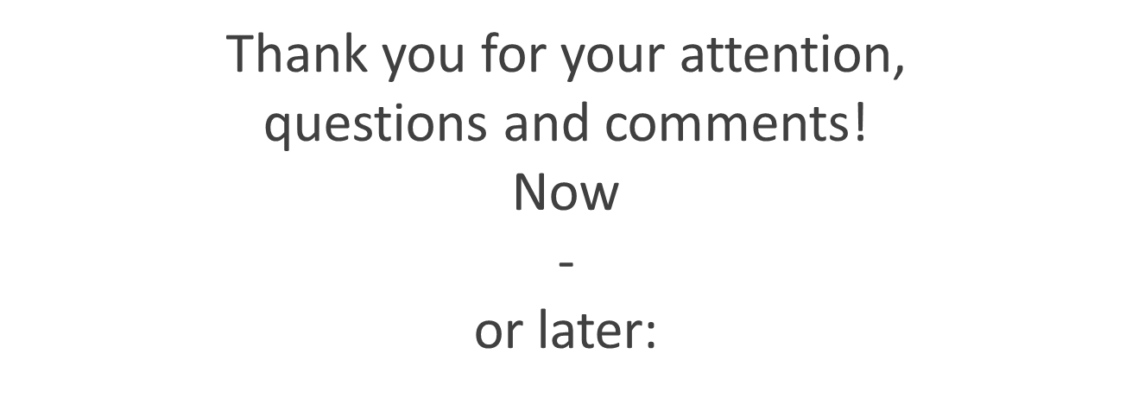
Andreas Saniter ITB Uni Bremen, DE asaniter@uni-bremen.de

