Slide 1
ICSAS - A Case Study on Supporting and Hindering Factors for Apprenticeships in Romania and Portugal
Andreas Saniter, ITB Uni Bremen
Rosana Pérez, INESCOP, Elda
03.05.2019, Crossing Boundaries, Valencia
This project has been funded with support from the European Commission. This publication reflects the views only of the author, and the Commission cannot be held responsible for any use which may be made of the information contained therein.
Notes:
1

Slide 2
Agenda
Background
Aims
Questions
Findings
Next steps
Spanish situation

Slide 3
Background I
Work-Based-Learning (WBL) as a promising approach to accelerate economic speed-up of south-European crisis states and post-socialist countries
policies to foster WBL on different levels:
EU/CEDEFOP
National policies
Bilateral agreements between German-speaking countries and others
Projects result (too often) in: More policy papers or internships

Slide 4
Background II
ICSAS project focusses on industrial shoe maker
ERASMUS+, DE (BIBB/NA) 3 years (09.2017-08.2020)
Participating countries: DE, PT, RO, ES
Partners: Companies & Shoe competence centres
involvement of stakeholders via Advisory Board

Slide 5
Aims of project
To develop the existing Vocational Education and Training (VET) systems of Romania and Portugal towards Work-based-learning (WBL), including a 1 year pilot.
Methodology: Policy Learning
To develop a sector qualification framework (SQF) in shoe industry and the referencing of national qualifications of Germany, Portugal, Romania, and Spain.

Slide 6
Questions
1.) What could be learnt via work-based learning?
Method: Learning Station Analyses (LSA)
2.) What should be learnt via work-based learning? (according to national regulations and curricula)
Method: Curriculum synopsis/design in RO and PT
3.) What are the supporting and hindering factors for Apprenticeships?
Method: Close supervision of the 1 year pilot, interviews with trainers, mentors and apprentices

Slide 7
Findings 1
1.) What could be learnt via work-based learning?
Skilled work in industrial shoe production can be described by 9 spheres of activity (e. g. design, cutting or finish)
All 3 participating plants in the 3 countries offer learning stations to all of the spheres
Partly different work organization; e. g. in DE 1 cutting department, in RO 3: automatic, manual, press cutting
=> Learning potentials are very similar!

Slide 8
Findings 2
2.) What should be learnt via work-based learning (WBL)?
PT drafted a dual curriculum of 1000 hours: Theory = 250 hours / Work-Based Learning = 750 hours.
RO drafted a 654 hours/year WBL curriculum.
Both inline with findings from 1 (LSA) and national regulations!
Details: http://icsas-project.eu/
=> Also countries with school-based VET offer options to exploit potentials of Work-Based Learning!

Slide 9
Findings 3
3.) What are the supporting and hindering factors for Apprenticeships?
Lessons learnt (so far):
“New” approaches conflict with traditions or beliefs.
=> Take all stakeholders on board!
Work-place mentors are a weak element, as they are not pedagogically skilled.
=> Train and guide them!
Even successful pilots depend often on the engagement of drivers and funding of third parties.
=> Try to establish them!

Slide 10
Next steps
PT group started already negotiations with competent bodies whether “our” ICSAS curriculum can be established to update an existing EQF level 2 qualification to a level 4 qualification.
RO colleagues see the potential that their finding could initiate the (re-) establishing of a VET-profile “industrial shoe producer” (currently only more general VET-profiles like leather-working).
We continue with promising grassroots initiatives – there will never be a silver bullet.

Slide 11
Spanish project partner
INESCOP

Slide 12
Who we are
Centre for Technology and Innovation
Independent service organisation → Footwear sector
Association of companies
Since 1971

Slide 13
8,000 m² premises
103 professionals:
70 % University graduates
15 PhDs
35 Patents
71 R&D&I projects in 2018
European: 16
National: 10
Regional: 22
Third countries: 23

Slide 14
OUR TRAINING EXPERIENCE
More than 25 years
Training designers, pattern makers and footwear technicians

Slide 15
Training
Express courses – Webinars – Tailored courses – Continuous training
Higher education (UA-INESCOP): Expert in Digital Design and Footwear Technology

Slide 16
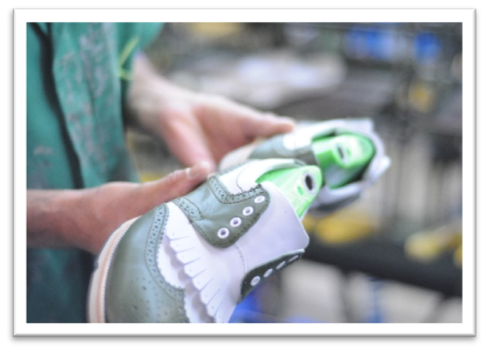
OUR CONTRIBUTION TO THE ICSAS PROJECT
Development of training manuals and learning teaching activities.
Technical translations

Slide 17
OUR CONTRIBUTION TO THE ICSAS PROJECT
Analysis of the links among National Qualifications framework with project results

Slide 18
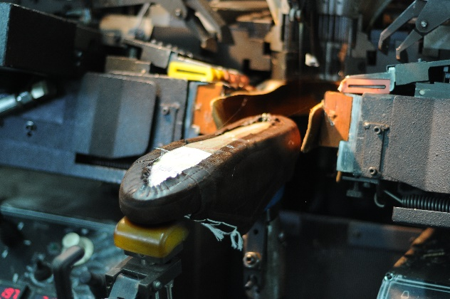
MANUALS AND TEACHING ACTIVITIES
Cutting
Prestitching
Stitching
Assembly
Prelasting
Lasting
Finishing

Slide 19
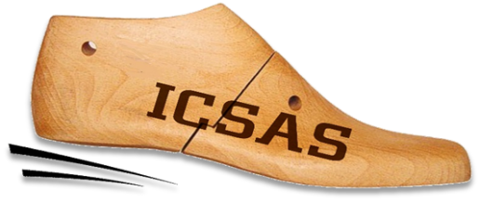
EXPECTED RESULTS FOR THE PROJECT IN SPAIN
Improvement of the VET tutors’ performance.
Establishment of the linkage of the Spanish qualification framework with the results of the project.

Slide 23
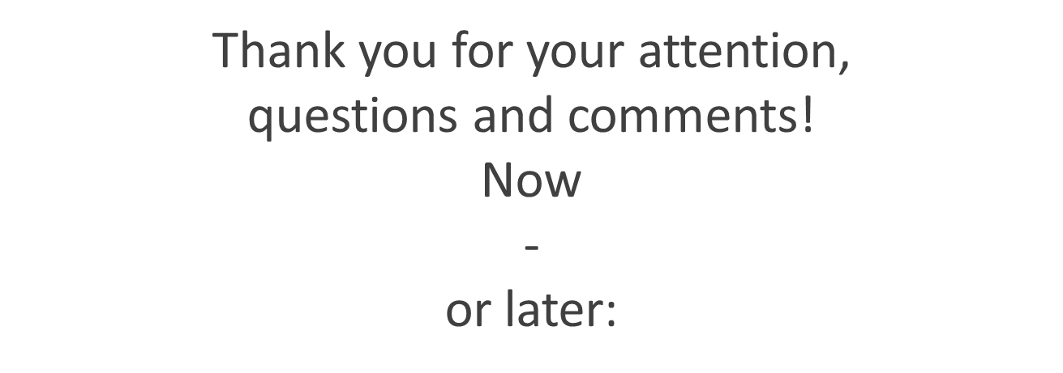
Rosana Perez INESCOP, Elda, ES rperez@inescop.es
Andreas Saniter ITB Uni Bremen, DE asaniter@uni-bremen.de

